Slide 1


B.N.M. Institute of Technology
An Autonomous college under VTU
Project Assessment Report
Course: Deep Learning and Reinforcement Learning
Project Title: Time-Series Forecasting for Weather Prediction.
Name | USN
Bharath B | 1BG23CS024
Hemanth S Gowda | 1BG23CS050

Slide 2

Objective
The primary objective of this project is to develop a machine learning model capable of accurately forecasting future temperature values based on historical weather data. With climate conditions becoming increasingly unpredictable, reliable weather prediction has become essential for sectors such as agriculture, transportation, and disaster management. This project specifically focuses on utilizing Long Short-Term Memory (LSTM) networks, a type of recurrent neural network well-suited for time-series data, to learn and model temporal patterns in weather variables. By analyzing past temperature trends and other related features, the goal is to create a system that can provide accurate short-term temperature forecasts, contributing to more informed decision-making in weather-sensitive areas.

Slide 3

METHADOLOGY AND WORKFLOW
Data Acquisition and Understanding:
Used the Jena Climate Dataset with 14 meteorological features recorded every 10 minutes over several years.
Performed exploratory data analysis (EDA) to understand feature distributions and correlations.
Data Preprocessing:
Handling Missing Values and Outliers: Detected and cleaned any missing or anomalous values to ensure data quality.
Feature Selection: Selected relevant features such as temperature, humidity, pressure, and wind speed.
Normalization: Applied MinMaxScaler to normalize features between 0 and 1 to help the model converge efficiently.
Time-Series Windowing:
Converted data into supervised learning format using sliding windows.
Example: Past X hours (e.g., 24 hours) used to predict the next Y hour (e.g., 1 hour ahead).

Slide 4

3. Data Splitting:
Divided the dataset into training, validation, and test sets.
4. LSTM Model Architecture Design:
Built an LSTM-based model using TensorFlow/Keras.
Tuned key hyperparameters like LSTM units, dropout rate, and activation functions (e.g., ReLU).
5. Model Training:
Trained the model using Adam optimizer and MAE/MSE loss functions.
Used a fixed number of epochs and batch size for learning.
6. Model Evaluation:
Evaluated model performance using MAE and RMSE metrics.
7. Prediction and Visualization:
Generated future temperature predictions using the trained model.
Visualized results with line plots for qualitative analysis.

Slide 5
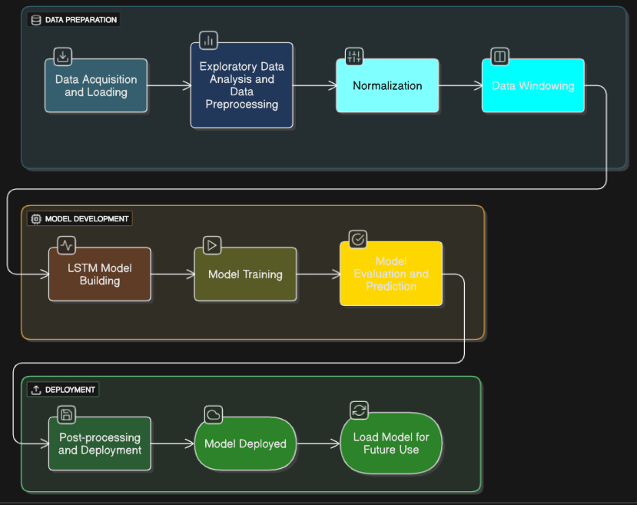
FLOWCHART

Slide 6

KEY ASSUMPITIONS
We assumed that the weather patterns in the Jena Climate Dataset remained reasonably stationary over time, allowing the LSTM model to learn consistent trends. The dataset was considered historically sufficient, containing meaningful patterns necessary for accurate future predictions. It was also assumed that the selected features—such as temperature, pressure, humidity, and wind speed—were relevant and adequate for modeling. Additionally, the project relied on having access to sufficient computational resources (CPU/GPU) for efficient model training. Lastly, we assumed no extreme or unprecedented weather events occurred that would significantly differ from the training data.

Slide 7
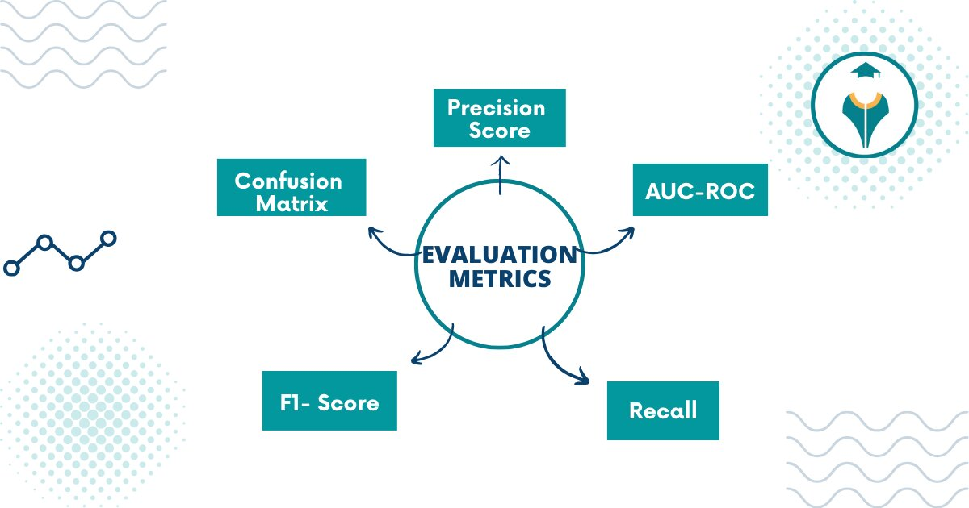
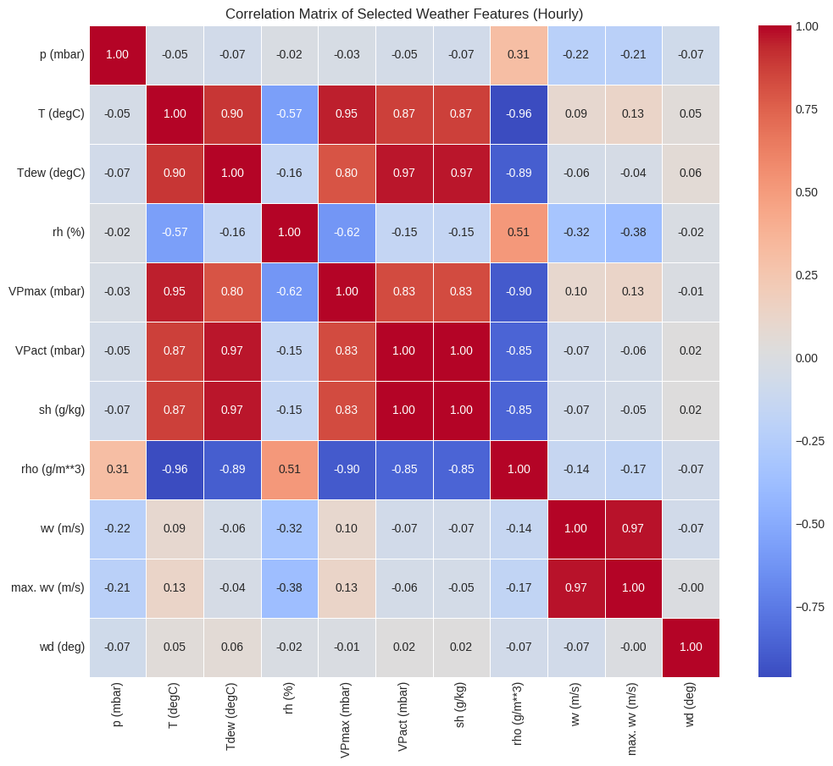
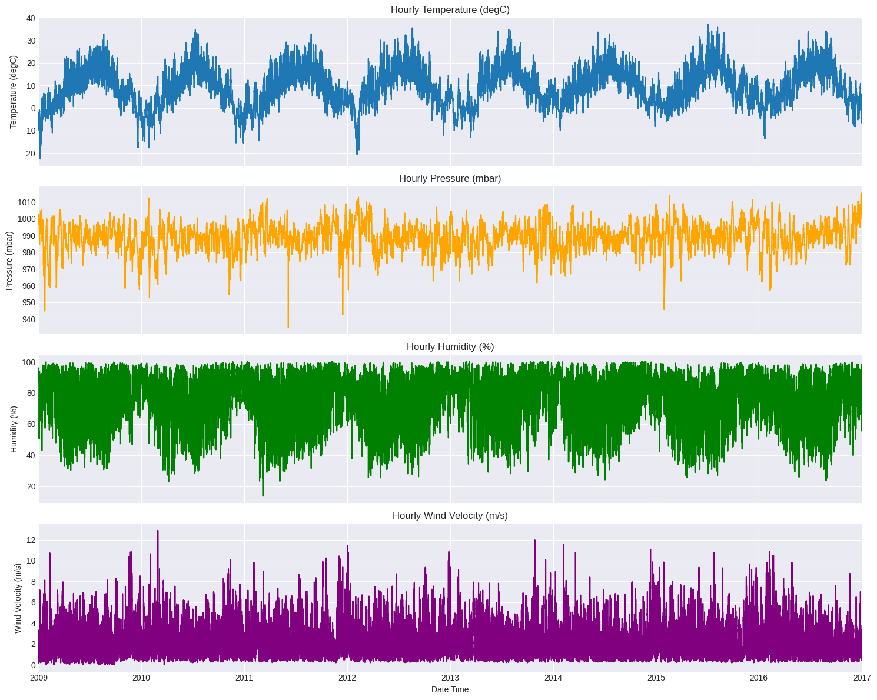
Model Evaluation and Analysis

Slide 8
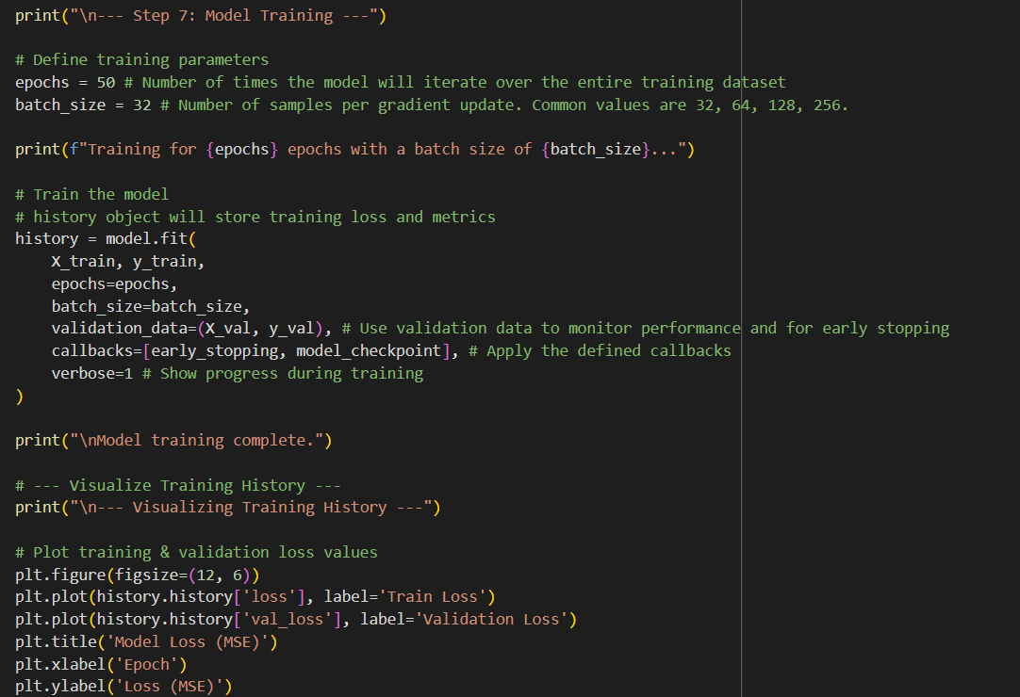
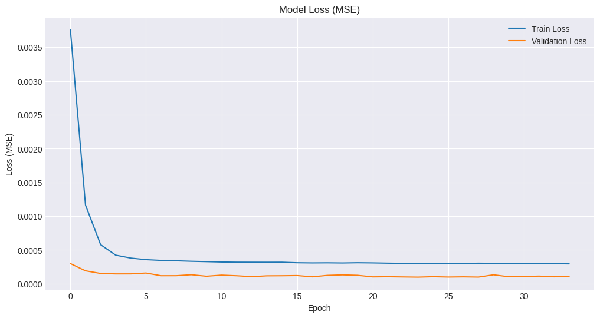
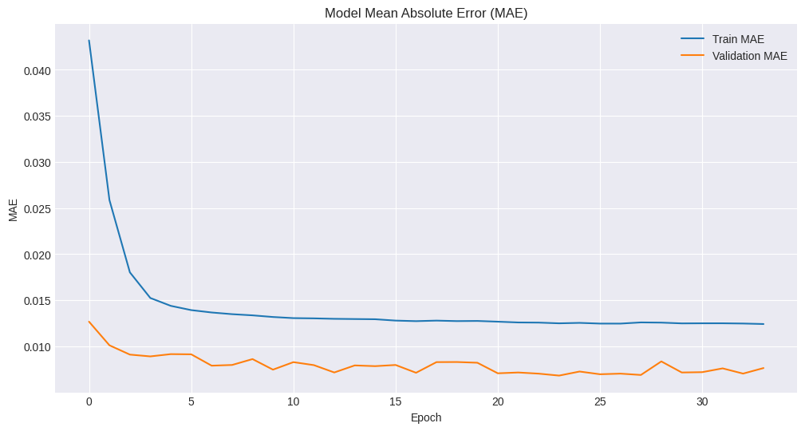

Slide 9
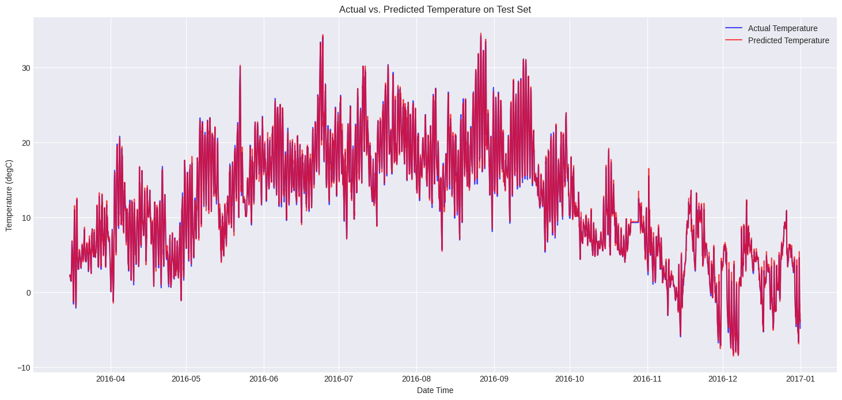
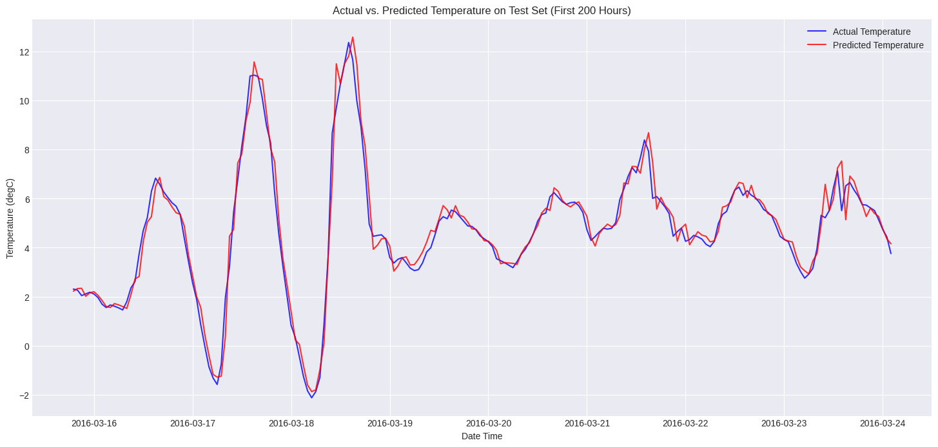

Slide 10

OUTCOMES
This project successfully demonstrated the application of LSTM networks for univariate/multivariate time-series weather prediction using the Jena Climate Dataset. We developed a robust pipeline covering data preprocessing, windowing, model building, training, and evaluation. The LSTM model proved effective in capturing the sequential dependencies within the climate data, leading to reasonable accuracy in forecasting future weather conditions. The project not only achieved its objective of building a functional prediction model but also provided valuable hands-on experience in dealing with real-world time-series data and deep learning architectures.

Slide 11

FUTURE ENHANCEMENTS
Use advanced hyperparameter tuning (e.g., Grid/Random/Bayesian Search) for better model performance.
Experiment with other architectures like GRU, Transformers, or CNN-LSTM hybrids.
Extend to multi-step forecasting for longer-term predictions.
Apply feature engineering (e.g., lag features, rolling averages, seasonality indicators).
Try ensemble methods to boost accuracy and robustness.
Integrate with real-time data sources for live forecasting.
Add uncertainty estimation to provide prediction ranges.

Slide 12

LEARNINGS
Understood preprocessing and windowing for time-series data.
Gained deep knowledge of LSTM networks and their structure.
Improved proficiency in TensorFlow/Keras for model development.
Realized the critical role of data normalization and feature engineering.
Learned to evaluate models using metrics and visualizations.
Faced real-world challenges in time-series forecasting.
Experienced the importance of iterative model refinement.

